Slide 1
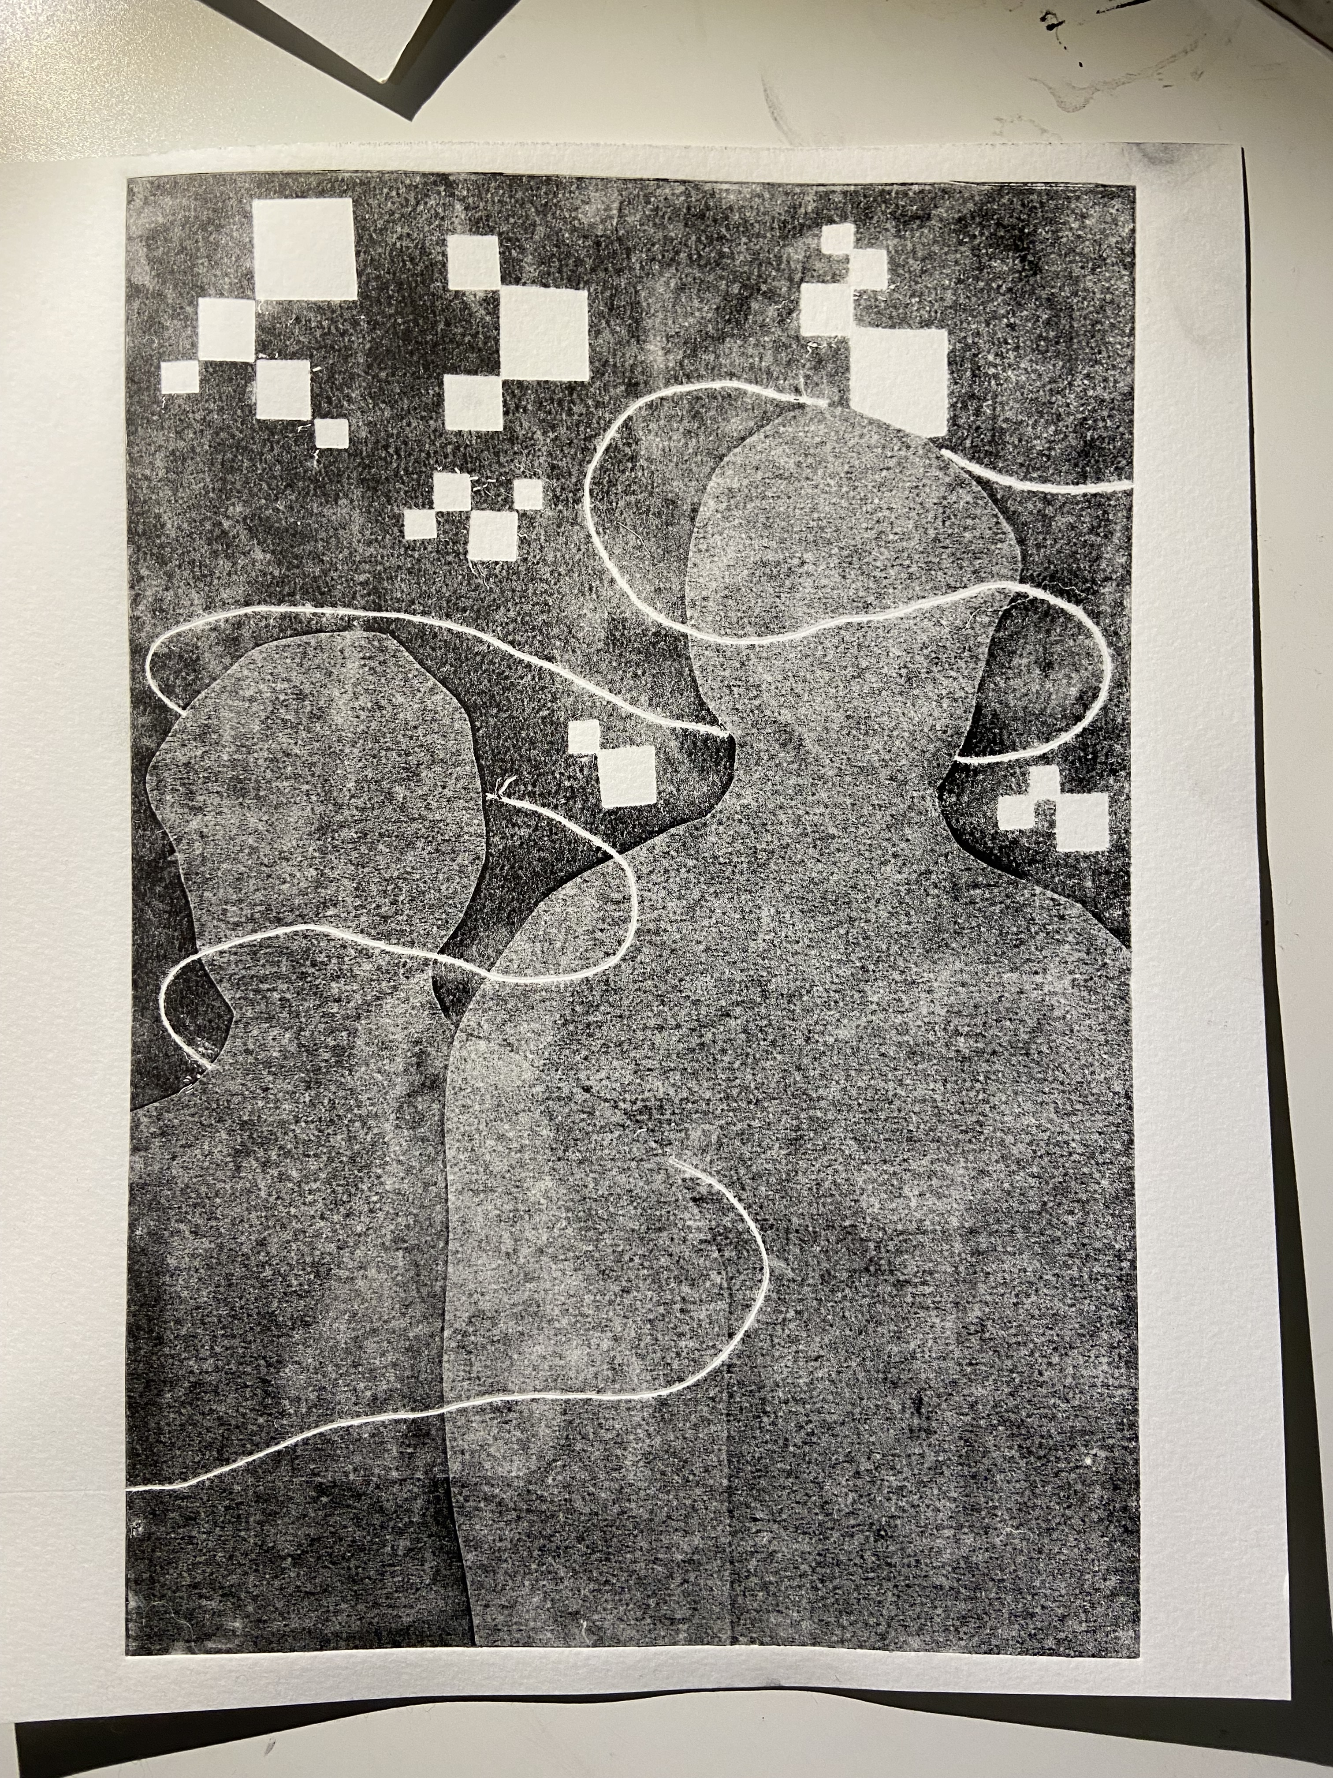
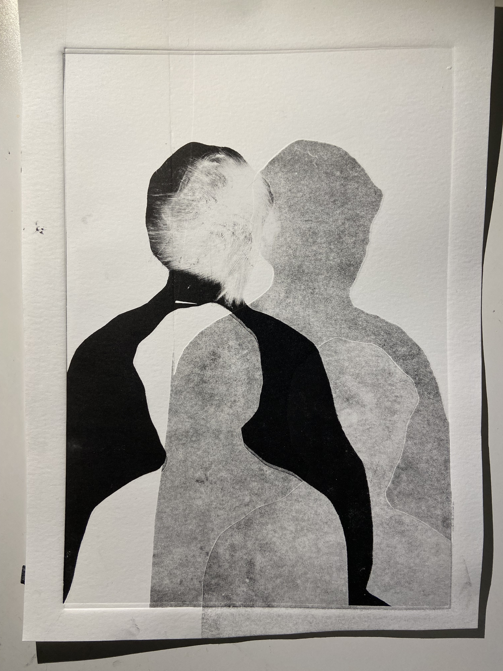
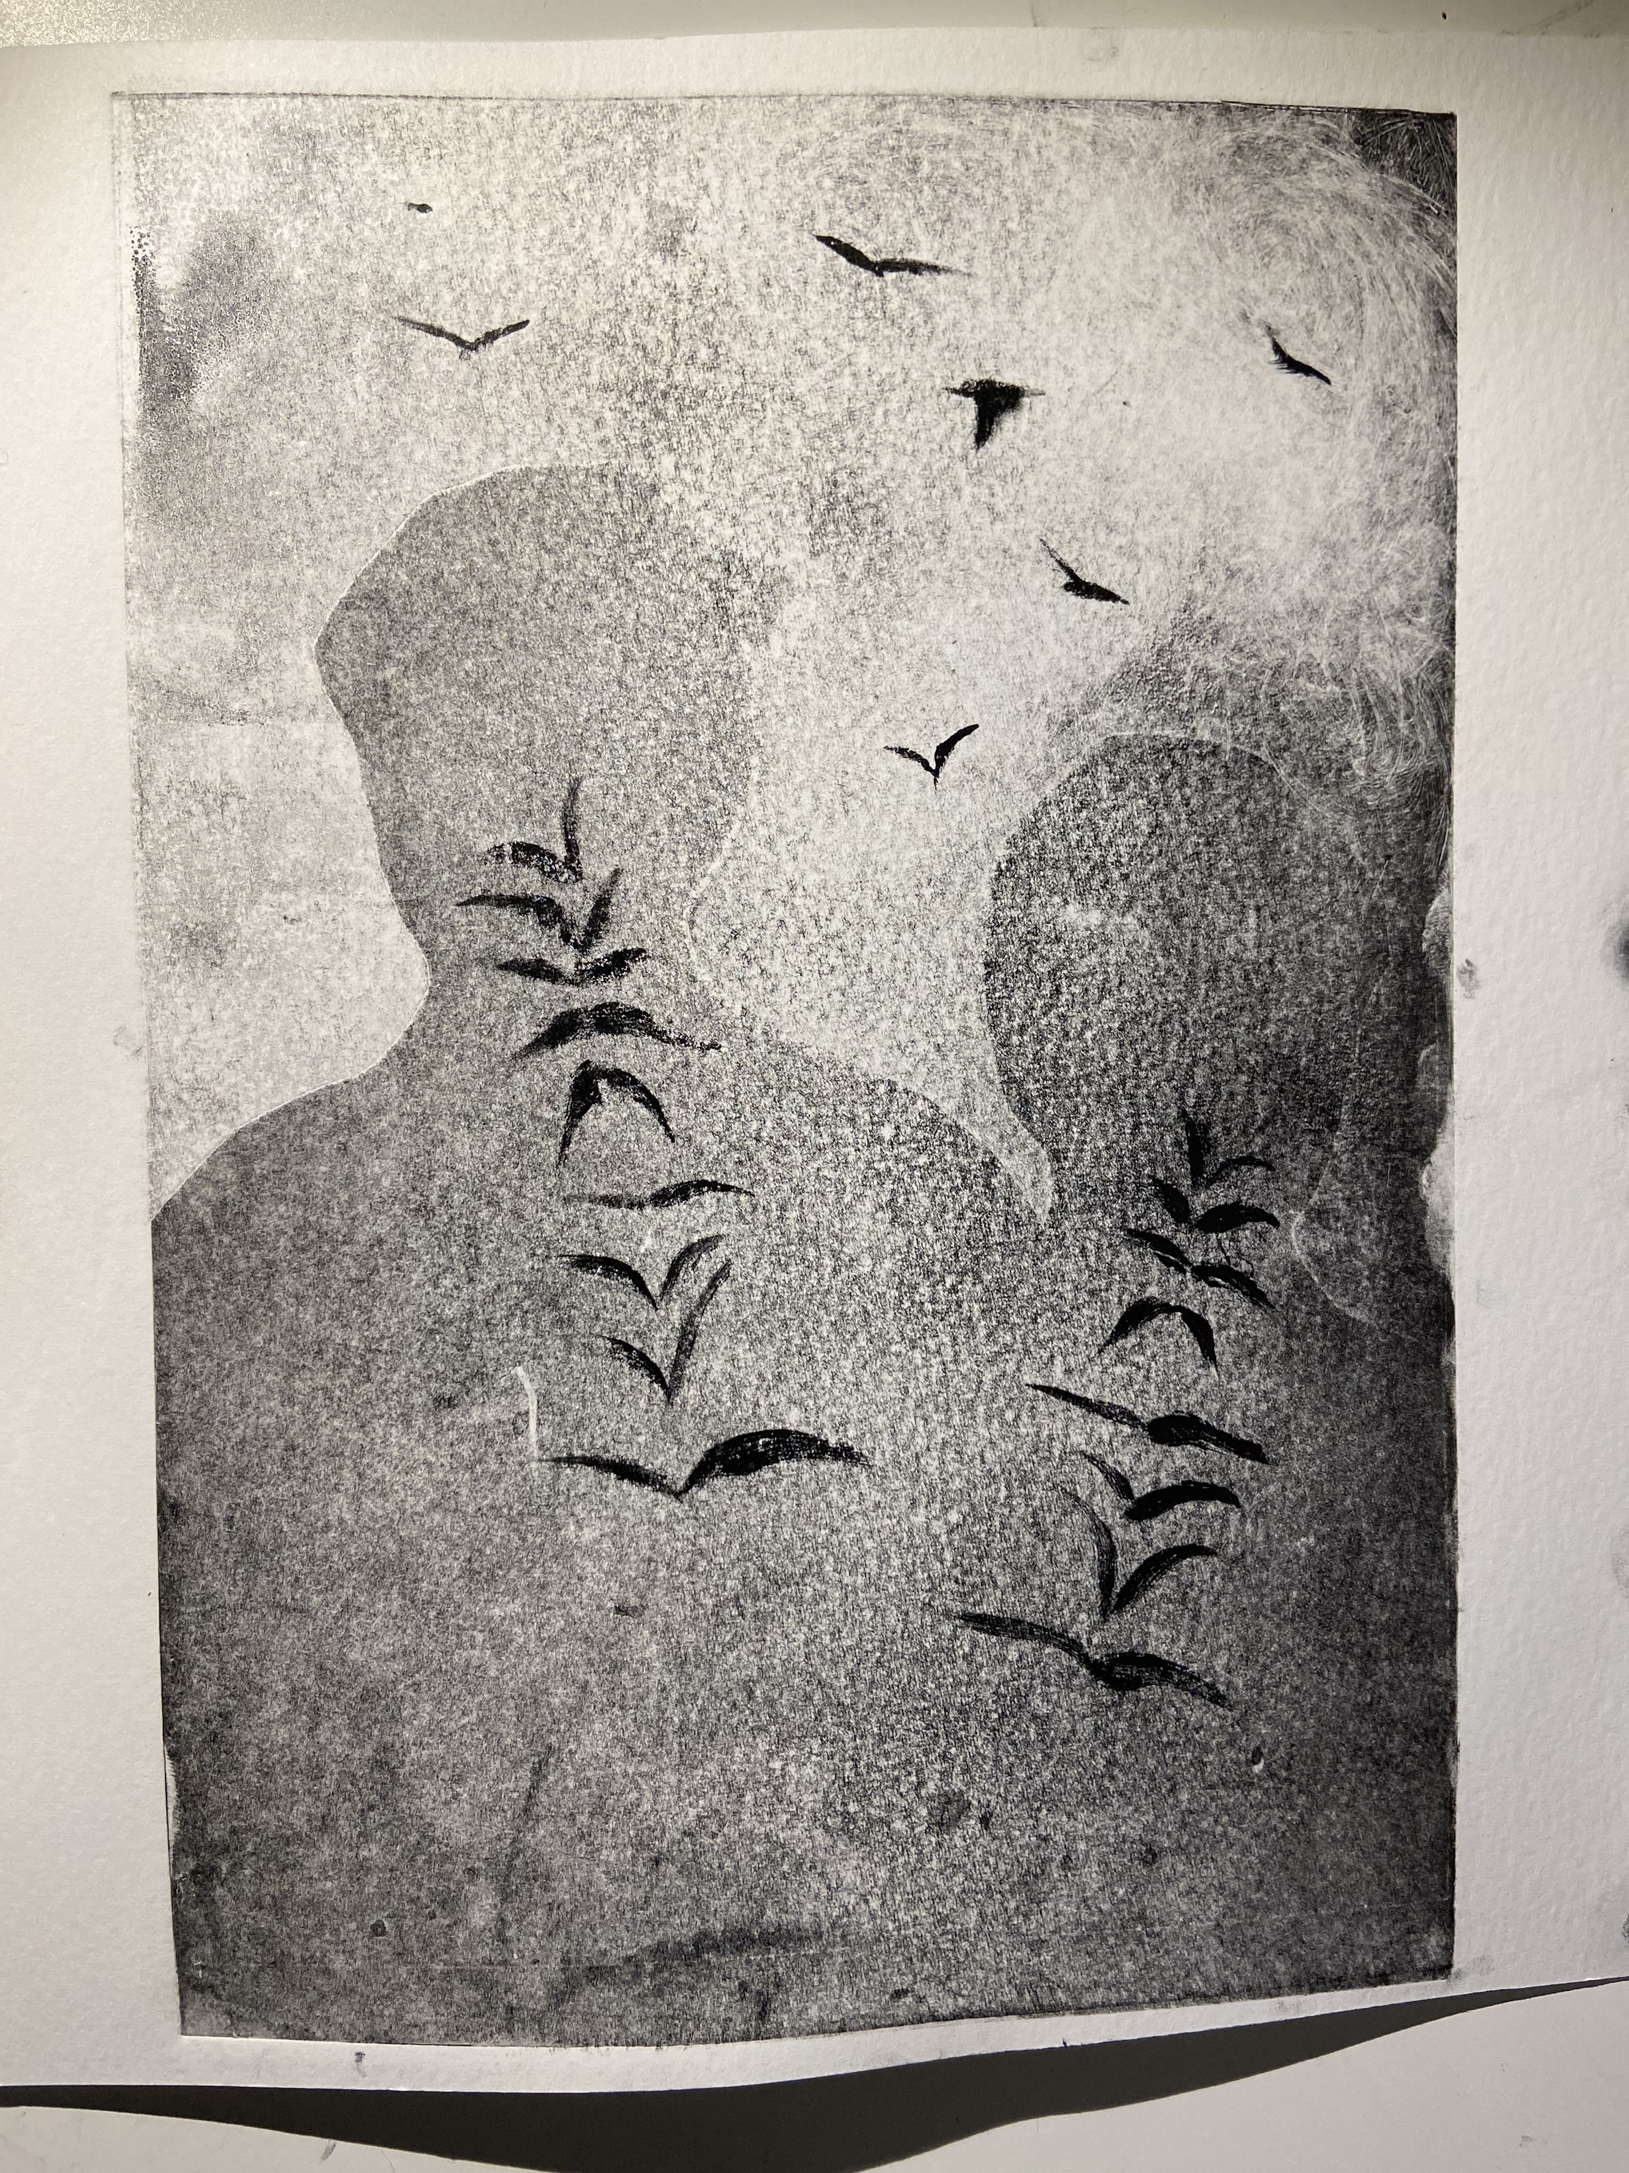
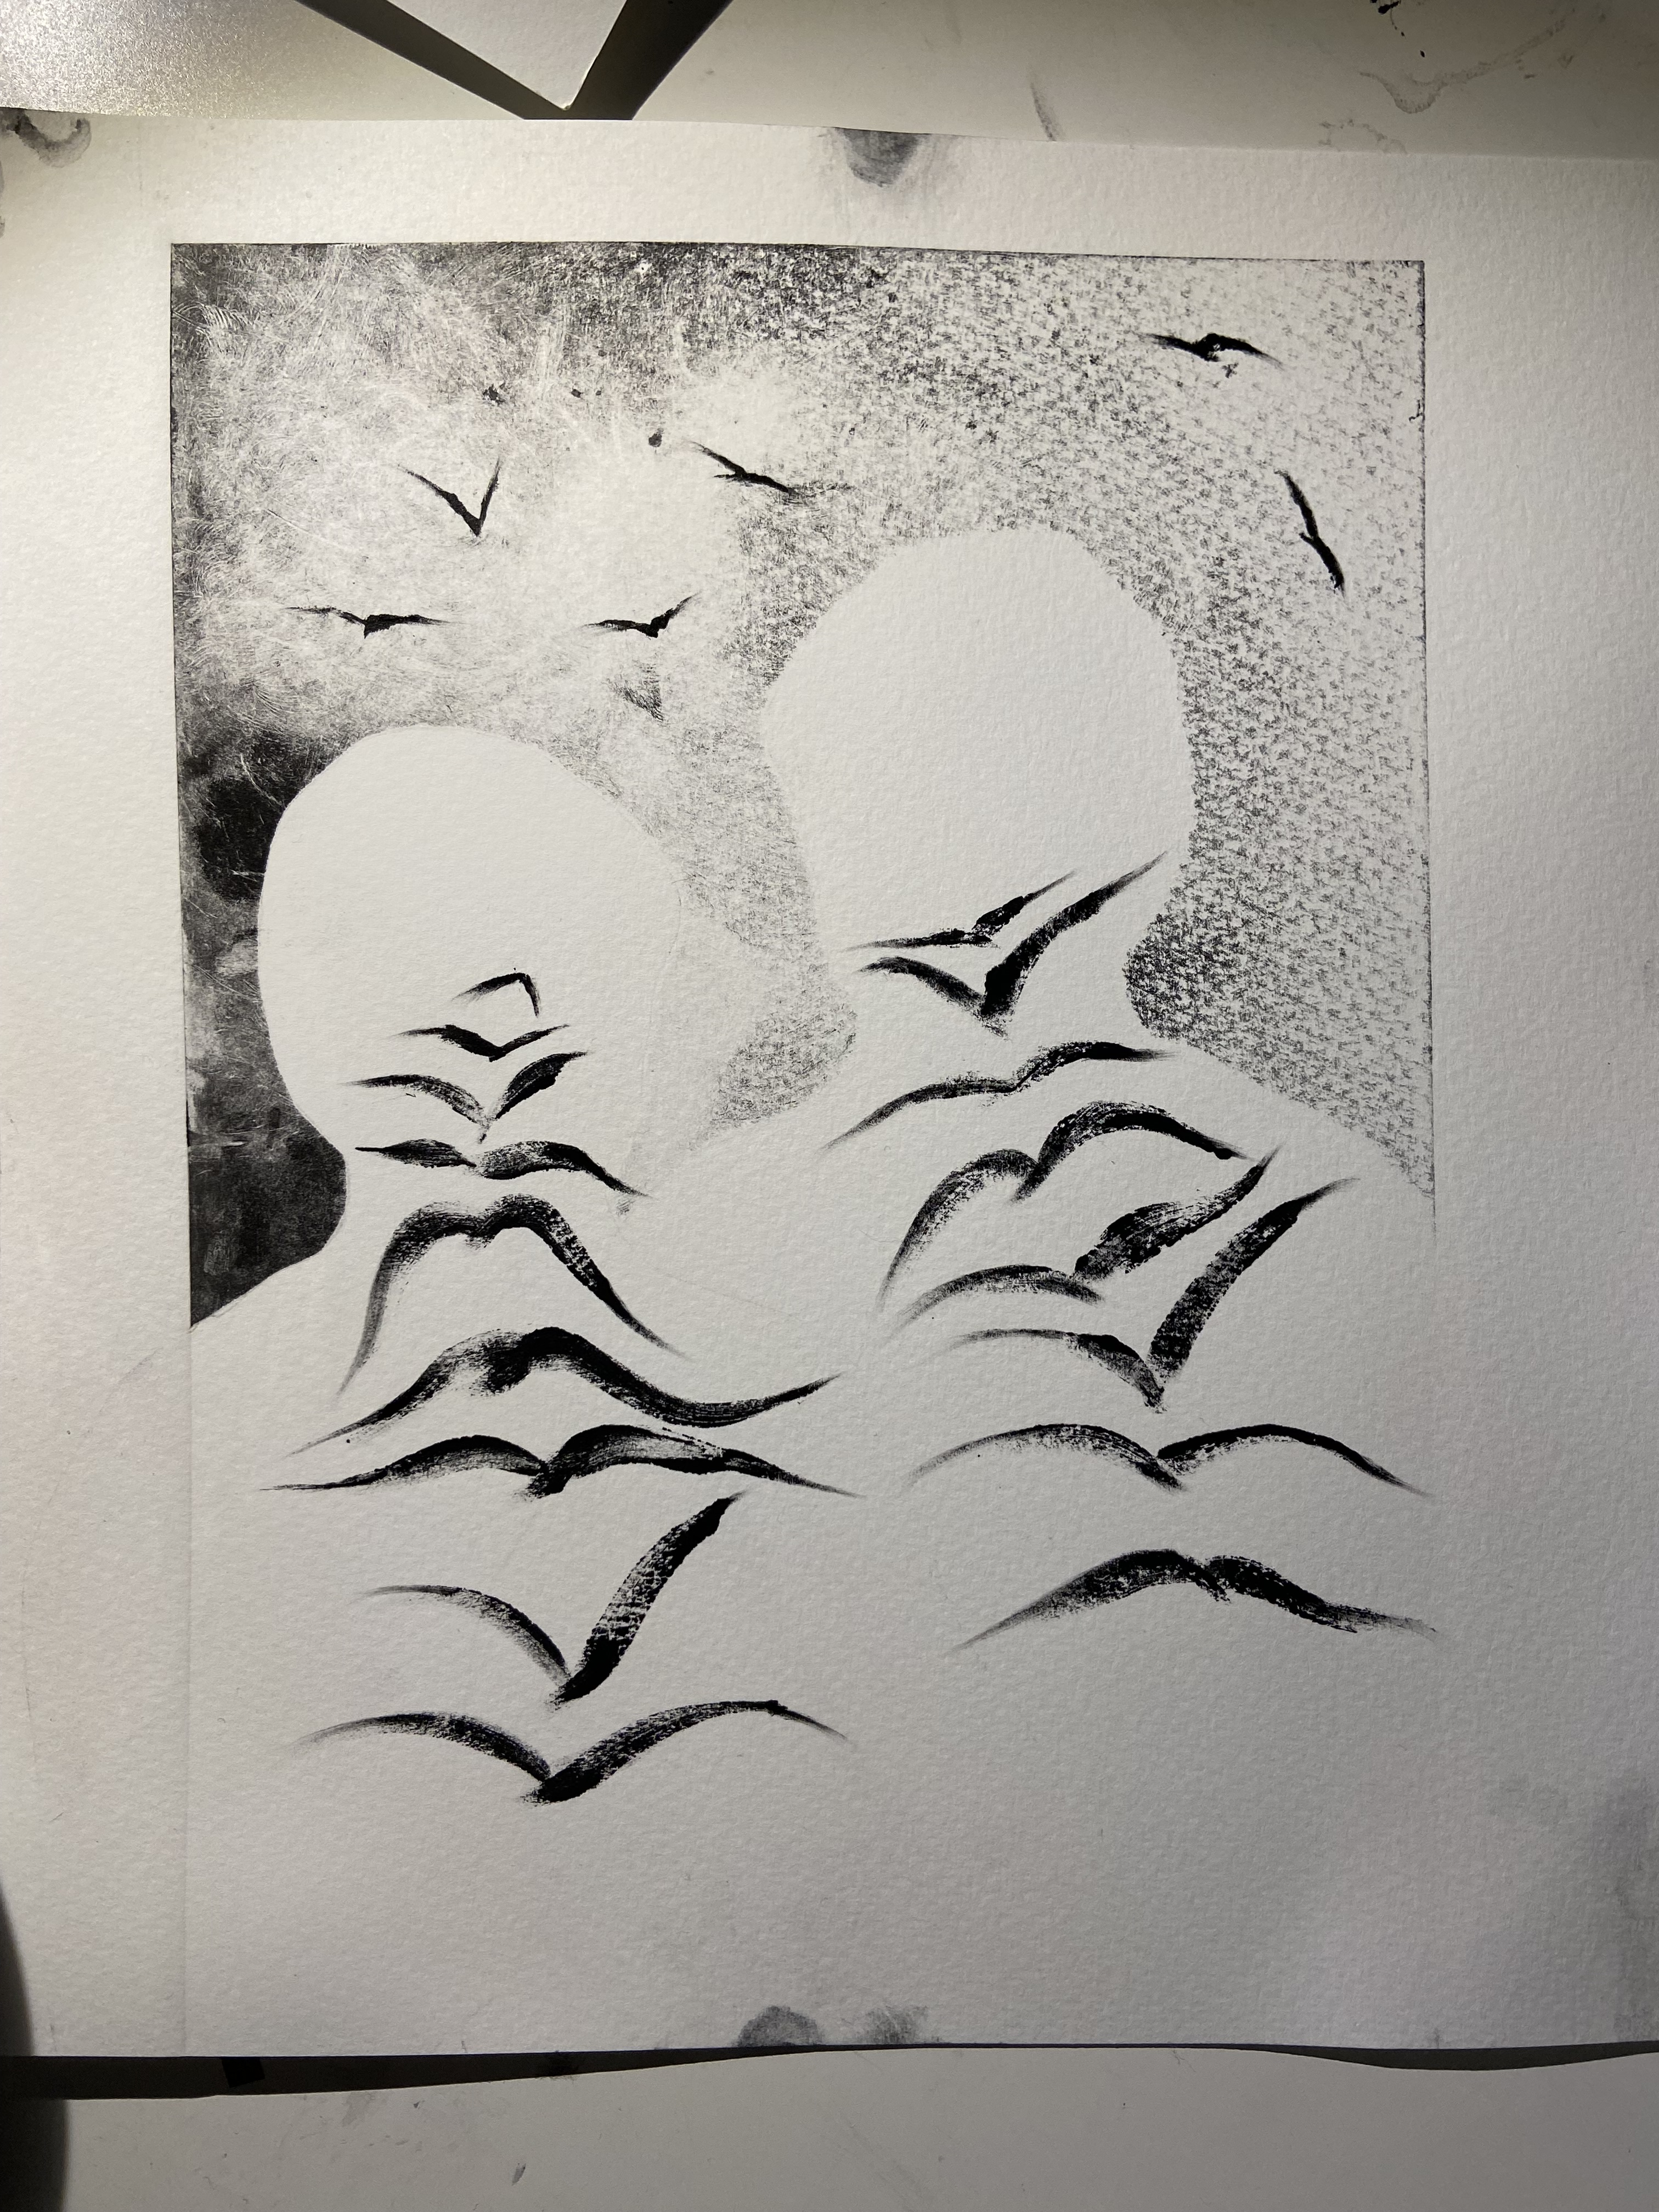

Slide 2
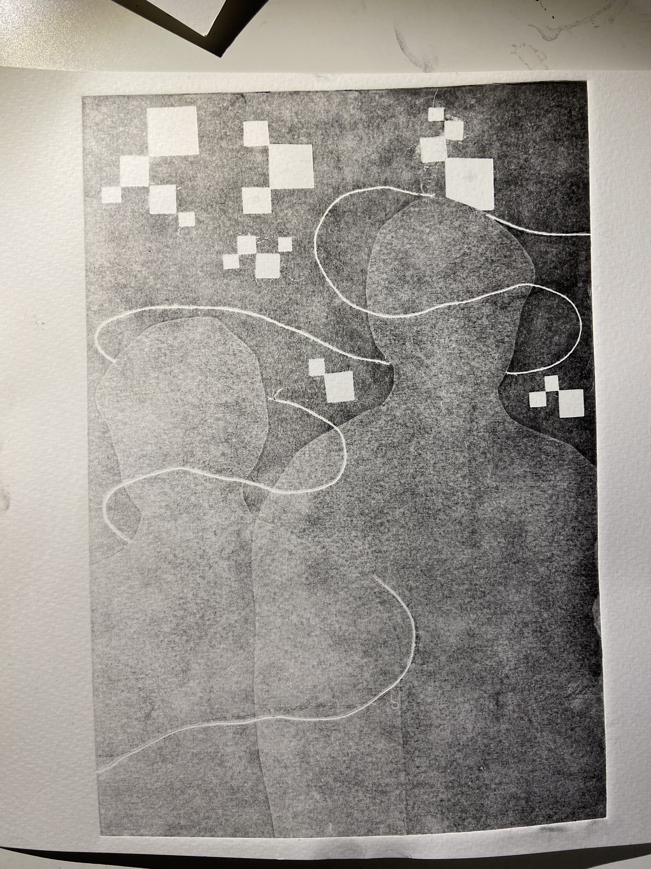
This print series is about how social media alienates and isolates us from each other and ourselves, while also suggesting how engaging more with the real world can be freeing. The two figures in the first print are linked by the thread of social media yet are turned away from each other, highlighting their detachment. The pixels also symbolize how social media is a warped version of reality, one that distorts our perception of the real world. In the second print, the theme is loosely about how living in the world of social media makes us out of touch with ourselves and our own sense of identity. The last two prints incorporate nature to show an alternative, freer version of how we can live– engaging with the real world by communicating with other people, as shown by the two figures now facing each other.

